Slide 1
INTELLIGENT TRANSPORTATION SYSTEMS
Intelligent Traffic
Signal Controller
A Finite State Machine approach to adaptive, sensor-driven traffic management at road junctions
Engineering Design Review • Digital Systems & Embedded Control
PRESENTED BY
T. Navya
M. Vyshali
D. Vishruth Goud
K. Sri Varshik Reddy
01

Slide 2

INTRODUCTION
Why Traffic Signals Need to Get Smarter
Urban traffic keeps growing, but most junctions are still run by fixed-time controllers that cycle through a rigid, pre-set sequence no matter how much traffic is actually present.
The result: green time is wasted on empty approaches while vehicles queue on busy ones. As city traffic volumes rise, that mismatch turns into real congestion, fuel waste, and driver frustration.
This project introduces a Finite State Machine (FSM) controller that reacts to live sensor data — bringing structure, safety, and adaptability to junction control.
40%
of urban commute time lost to congestion and avoidable idling at junctions
Fixed cycle timings persist even when one approach sits empty and another is queued — a rigid model with no feedback.
02

Slide 3




DEFINITION
What Is a Finite State Machine?
A Finite State Machine (FSM) is a computational model that exists in exactly one of a finite number of states at any moment. It moves — or transitions — from one state to another in response to inputs called events, and each transition can trigger an output action.
State
Event
Transition
Action
A distinct condition of the system — e.g. “North-South Green.”
An input that triggers change — a timer expiry or a sensor reading.
The move from one state to another, caused by an event.
An output on entering or leaving a state — e.g. switch a lamp.
03

Slide 4
ABSTRACT
Project Abstract
This project models an intelligent traffic signal controller as a Finite State Machine, representing every junction phase — green, yellow, and all-red — as a discrete, verifiable state.
Real-time vehicle-density data from per-lane sensors drives state transitions in place of a fixed clock, letting green time stretch or shrink with actual demand while hard safety bounds and mandatory clearance intervals are always enforced.
A cycle-by-cycle simulation compares the adaptive FSM controller against a conventional fixed-time baseline on identical traffic demand, quantifying the reduction in average vehicle delay.
-41%
average delay reduction across all traffic profiles
-43%
improvement measured during peak-hour congestion
0
unsafe or conflicting phase transitions observed
04

Slide 5



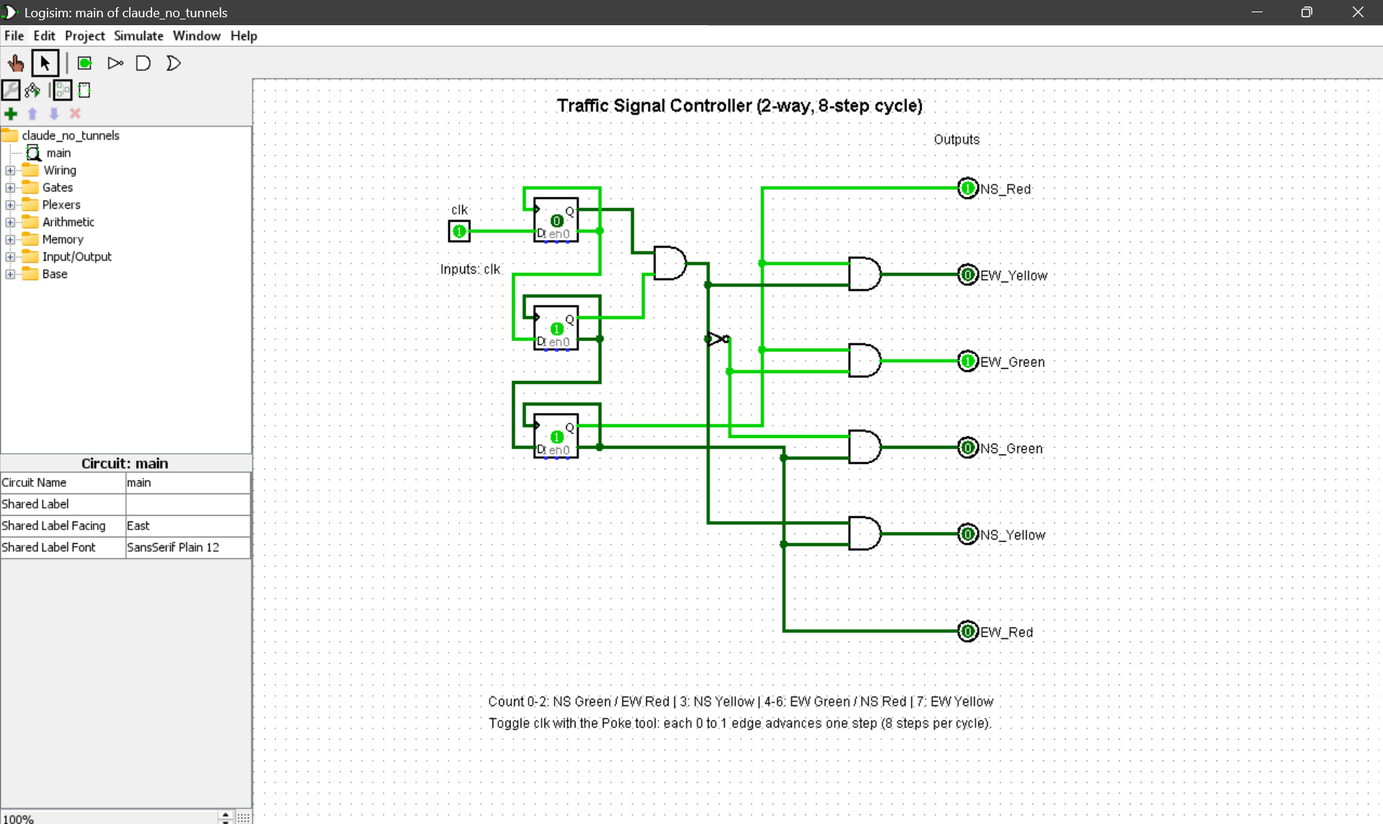
ARCHITECTURE
System Architecture & FSM Logic
Sensing Layer
→
FSM Controller
→
Signal Output
Inductive-loop / IR / camera density feed
Evaluates state, applies transition rules
Drives red / yellow / green lamps
Feedback: state history & lane occupancy loop back into the controller every cycle
STATE TRANSITION DIAGRAM
S0
NS Green
S5
S1
All-Red
NS Yellow
S4
S2
EW Yellow
All-Red
S3
EW Green
Cycle: NS Green → NS Yellow → All-Red → EW Green → EW Yellow → All-Red → repeat
05

Slide 6



BENEFITS
Benefits & Advantages
Formally Verifiable
Lower Average Delay
Deterministic Behaviour
Every state and transition can be checked and certified for safety.
Adaptive green time cuts stop-and-go queues at every approach.
Predictable, testable logic — easier to validate before deployment.
Simple to Implement
Scales Cleanly
Safe by Construction
Maps directly to a state table in software, HDL, or an FPGA.
Extends to multi-phase and multi-junction coordination.
Guarded transitions make conflicting phases structurally impossible.
06

Slide 7





APPLICATIONS
What Are the Uses?
Smart-City Intersections
Emergency Pre-emption
Pedestrian Crossings
Green-Wave Corridors
Research Testbed
Core adaptive control for urban junction networks.
Priority routing and signal override for emergency vehicles.
Adaptive walk-phase timing integrated with vehicle states.
Coordinated timing along arterial roads for smoother flow.
A structured baseline for reinforcement-learning traffic control.
07

Slide 8
CONCLUSION
Conclusion & Future Scope
An FSM-based intelligent controller gives adaptive traffic signal control a safe, verifiable structure — and simulation confirms meaningful delay reductions over fixed-time systems, without compromising the strict safety guarantees a junction demands.
PROJECT AT A GLANCE
6
junction states modelled
-41%
average delay reduction
Extend to a hierarchical FSM coordinating multiple adjacent junctions
Hybridise with reinforcement learning for continuous timing optimisation
0
unsafe transitions
Add V2I connectivity for vehicle-reported demand data
Prototype on an FPGA / embedded platform for field testing
08

Slide 9
OPEN FLOOR
Any Questions?
Happy to walk through the state design, the sensor-driven transition logic, or the simulation results in more detail.
09

Slide 10
Thank You
Design and Simulation of an Intelligent Traffic Signal Controller Using FSM
10

